Slide 1
Syrup dispenser
Project by Franziska Rothen & Meindi Zahiri

Slide 2
features
inputs
outputs
Weighing scale to determine glass size & syrup/water level
Choice of syrup percentage via potentionmeter
End stop to home the platform
Motor to move the glass
Valves to fill the glass
LCD menu for navigation
Communication between the two µ-controllers via USART

Slide 3
hardware
2 nucleo
1 mbed shield
2 electrovalves
Linear actuator (stepper motor)
Drv8825 driver
1kg load cell + Hx711 amplifier
Level shifter
2 relays
12V power supply
CO2 tank
Love

Slide 4
Functionalities
SPI: LCD Screen
Timer: Debouncing
GPIO: Weighing scale
ADC: Potentiometer
USART: Communication

Slide 5
Spi – lcd screen
LCD_Driver library
Navigation:
Move forward in menu via button
Display prompts and results
General Info

Slide 6
Spi – lcd screen
int step = 0;
if(button pressed)
step ++;
if(step == 0)
menu1_display();
else if(step == 1){
menu2_display();
other_functionalities();
}
else if (step == 2)
…
Pseudocode

Slide 7
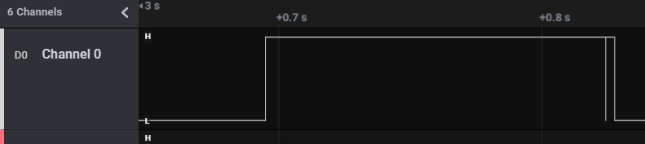
Timer – debouncing
Problem: skip step in menu
Solution:
Timer in interrupt mode
TIM 1
Internal clock
Frequency = 20Hz
General Info

Slide 8
Timer – debouncing
bool button_state = true;
if(button pressed && button_state == true){
start timer;
button_state = false;
}
if(timer period elapsed){
if(button is reset){
step ++;
button_state = true;
stop timer;
}
}
Pseudocode

Slide 9
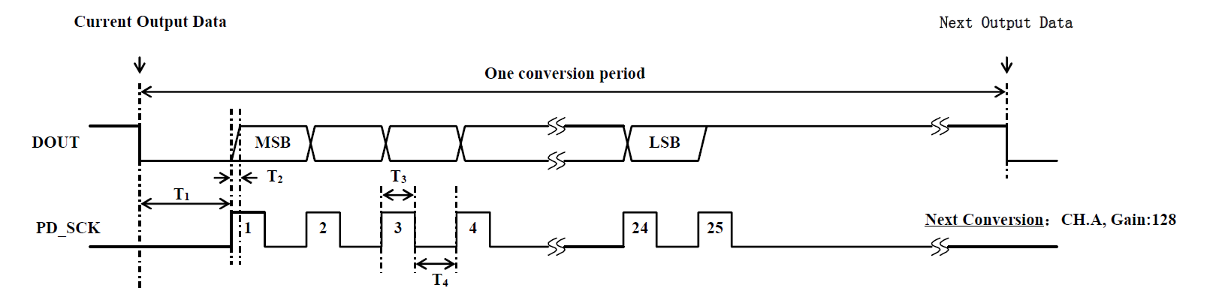
GPIO – weighing scale
24-Bit ADC: HX711
HX711 library
2 GPIO pins:
DOUT (input)
PD_SCK (output)
Calibration
Check weight for glass size
Check weight to stop syrup at percentage
General Info

Slide 10
adc – potentiometer
ADC 1
12-bit mode
Scan conversion mode: enabeled
Values divided into 20 segments
5% up to 25% syrup (switch case)
General Info

Slide 11
usart – communication
USART 1
Asynchronous mode
Information to send:
Open/close the valves
Move the glass
General Info

Slide 12
platform
Motor
Stepper motor with stepper driver (2 pins)
Endstop
Homing
Safety
General Info

Slide 13
Pneumatic
3/2 way electrovalve
Bottles under pressure
Endstop
Homing
Safety
General Info

Slide 14
Discussion
Valves operating pressure
Communication robustness (heartbeat, checksum)
Gpio reset state
Control for the flow
Scale readings could be improved
Menu improvement
General Info

